Slide 1
RTOS Final Project Bluetooth Mouse
第六組
廖振涵 N26102018
邱偉城 N26101884

Slide 2
Outline
Motivation
System Architecture
Demo video
Notes:
這是我的outline

Slide 3
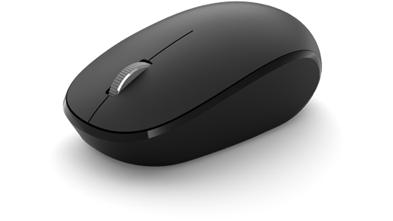
Motivation
Feature of RTOS.
Notes:
這是我的outline

Slide 4
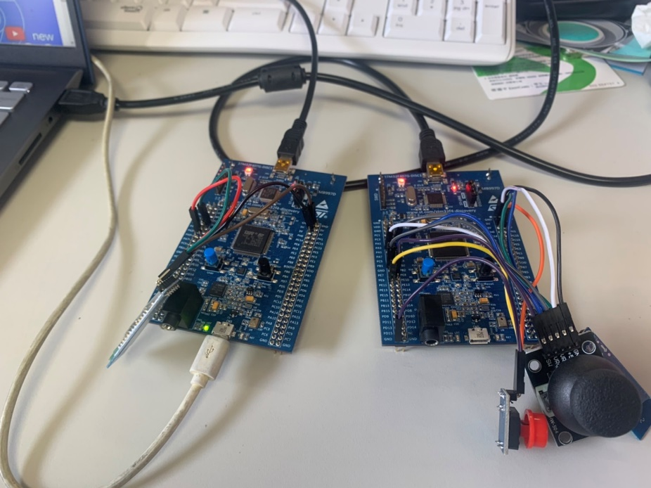
System Architecture
STM32F407G-disc1 x2
HC-05 x2
Joystick x1
Button x1
Notes:
這是我的outline

Slide 5

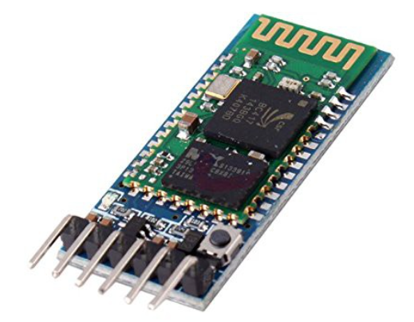
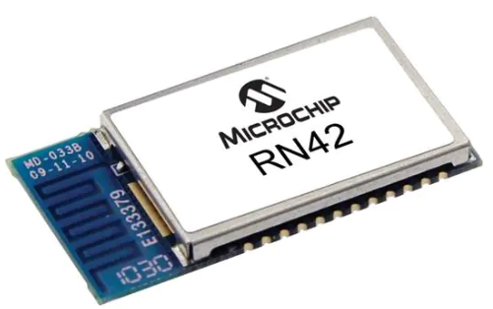
Bluetooth HID
Notes:
這是我的outline

Slide 6

System Architecture
Hc-05
Hc-05
STM32-disc1
STM32-disc1
Joystick
Button
Notes:
這是我的outline

Slide 7
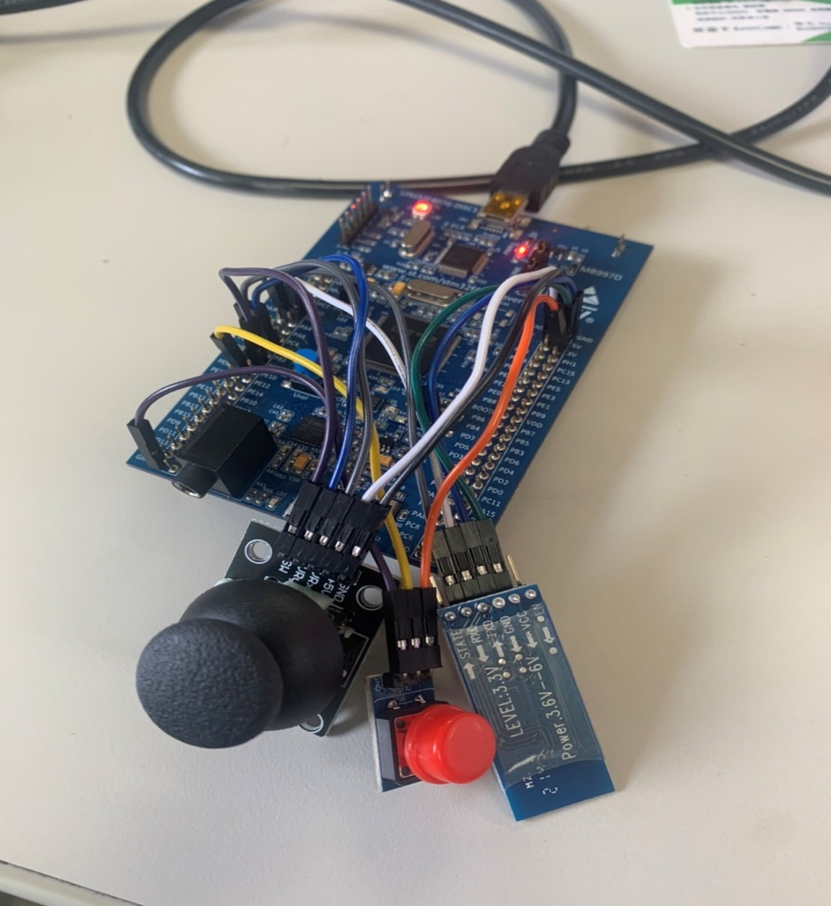
System Architecture
Sender(Mouse)
ADC
Joystick
Bluetooth(Master)
Notes:
這是我的outline

Slide 8
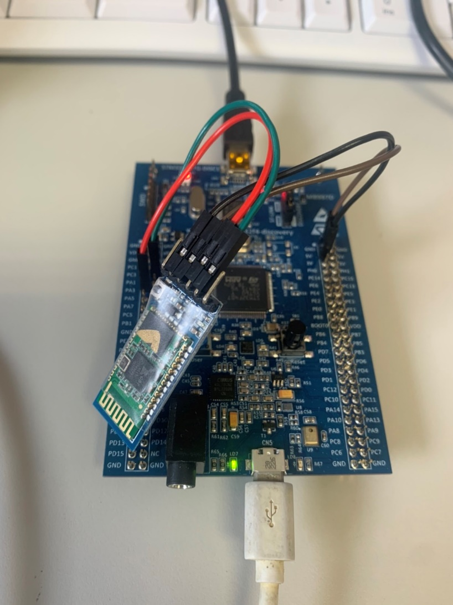
System Architecture
Receiver
HID
Semaphore
Bluetooth(Slave)
Notes:
這是我的outline

Slide 9
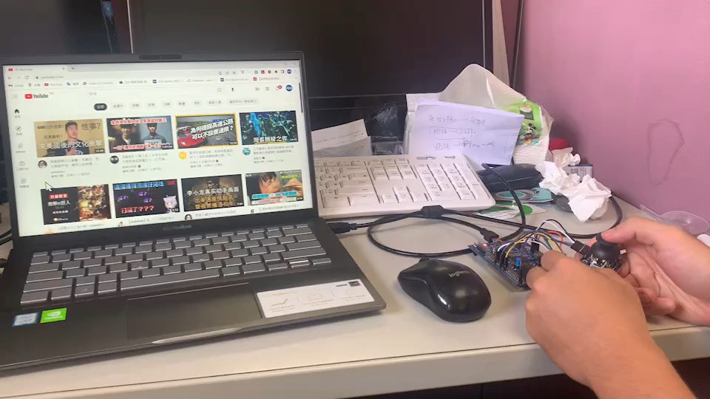
Demo vedio

Slide 10
Thank you!

